Slide 1

The 6 Elements
Value Proposition Template

Slide 2

The 6 Elements method is the worlds most popular way to build a Value Proposition in just 6 simple steps.
This method has been used to develop innovation in 27 countries for the worlds biggest technology companies such as Samsung, GE, Philips, GSK, Carestream, Analogic, Idexx, Citrix, Gemalto, Thalis, Lafarge, Bank of America, Aon, Electrolux, DSM, Belkin, Unilever, Pfizer as well as for incubators, start ups and University faculties. Users of the 6 Elements method are major innovators and have a history of success with a combined turnover exceeding 100 Billion Dollars.
To find out more about our materials, training and consultancy services visit www.TheSixElements.com

Slide 3
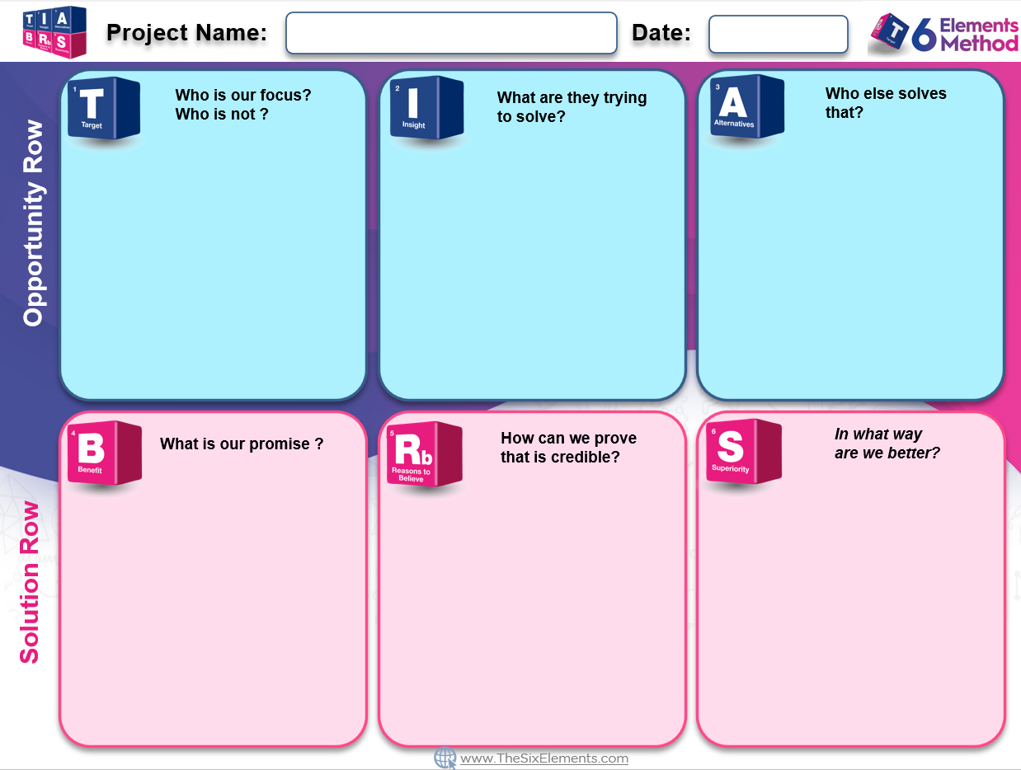
Type your project details and owner here
Date & Version
The information in this box describes the person or group for whom your proposition will be first choice.
You should ensure that any segmentation you choose is measurable and reachable.
It is equally important to describe who this proposition will not be suitable for.
If there are multiple stakeholders in a B2B chain, this box should contain the key stakeholder and be accompanied by the stakeholder chain document.
The information in this box describes the targets biggest unmet need.
You should ensure that this is not an observation by establishing not just what is happening, but why this is happening.
A useful written structure is:
Situation - What are they trying to achieve? (The context and motivation)
Dilemma – What is stopping them?
Perfect Situation – What do they want?
The information in this box describes relevant competitors to your proposition as defined by the target.
You should list both direct and indirect competitors including solutions that use a different method to solve the same problem.
Explain what the strengths and weaknesses of each alternative are from the target’s perspective.
If an alternative includes that the target does nothing, this must be included
The information in this box describes the advantage of this proposition.
The benefit should be a promise to solve the perfect situation in the insight.
As a result there should only be one single minded rational benefit linked to the emotional reward the target will receive as a result.
Avoid putting your technology or features as the benefit. A benefit is what the target gets, not how it gets it.
The information in this box describes how you intend to prove the proposition will deliver the benefit.
This can be a combination of technical data, endorsements, testimonials, statistics , and an explanation of how the technology works
There should be no information in this box that doesn’t tie directly to supporting some aspect of the benefit.
Any specification or feature that does not relate to the benefit should be captured elsewhere.
The information in this box distils in a single sentence how your proposition is better at delivering the benefit than competitors
This should be a single sentence that sums up the superior value of this proposition and should be relative to other alternatives.
The sentence might start with, Only x can..
x uniquely… X is better at…
Avoid making your technology the point of differentiation so you don’t get associated with a method not a benefit

